Slide 1

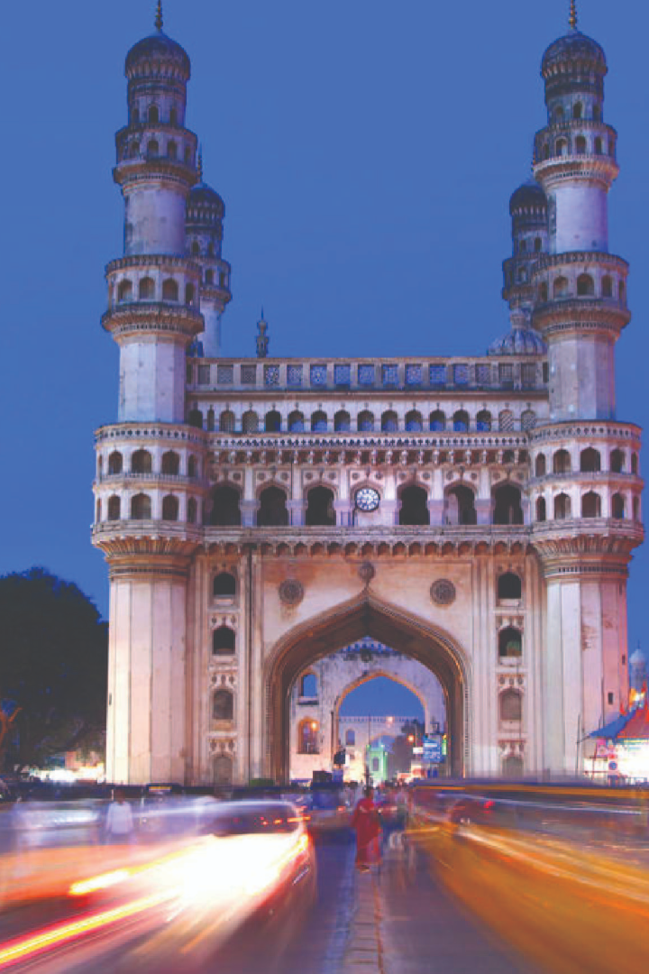

Telangana Growth Analysis
by Jegan Balaji B S
Dept of CSE, Indian Institute of Technology Kanpur

Slide 2
Objectives
Welcome to our analysis of Telangana's economic growth. I have identified several key factors that have contributed to the region's success. Join me as we explore these factors in detail.
Explore Stamp Registration, Transportation and Ts-Ipass Datasets.
Understand their attributes, categories and time period.
Analyze trends and patterns within each department.
Identify growth opportunities and areas needing attention.
Find correlation among these departments and report the overall growth of the state through insights and relevant visuals such as shape maps.

Slide 3
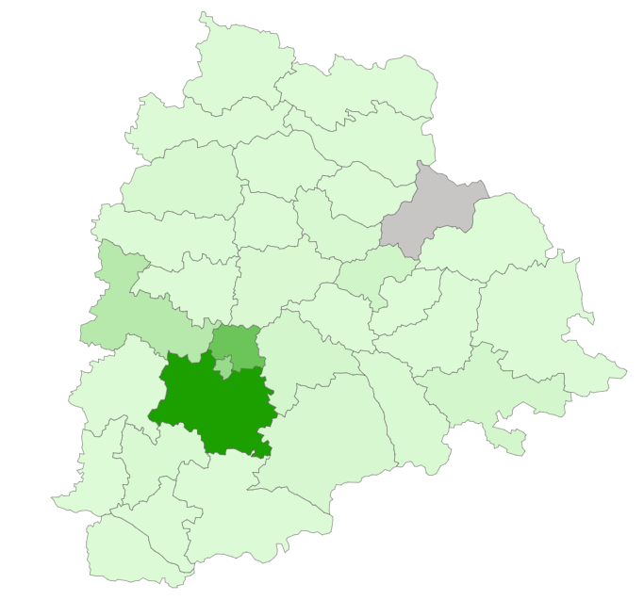
Document Registration Revenue(FY2019-FY2022)
Document Registration Revenue District-wise(FY2019-FY2022)
Top 5 Districts with Highest Document Registration Revenue Growth between FY2019 and FY2022
1
Mulugu
2
Adilabad
3
Karimnagar
4
Mancherial
5
Medchal Malkajgiri

Slide 4
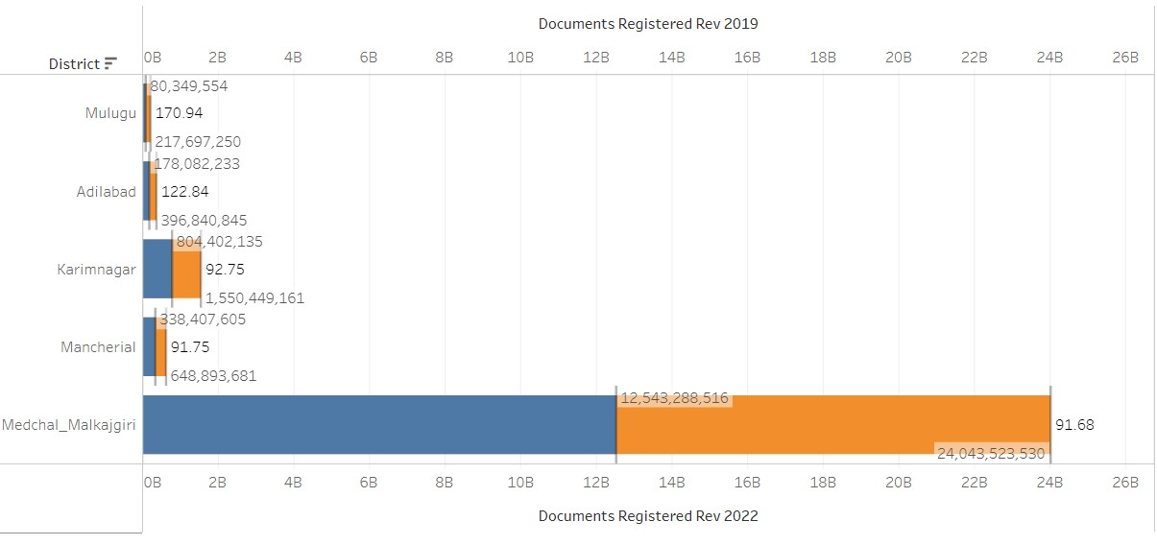
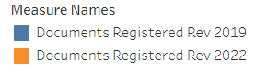
Top 5 Districts with Highest Document Registration Revenue Growth between FY2019 and FY2022
Note: Middle value in each bar represents percentage difference

Slide 5
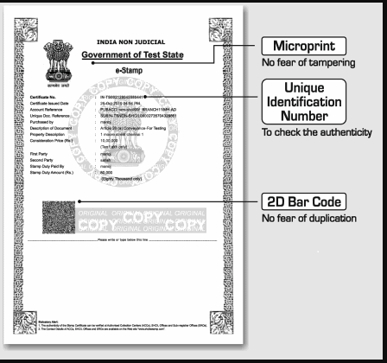
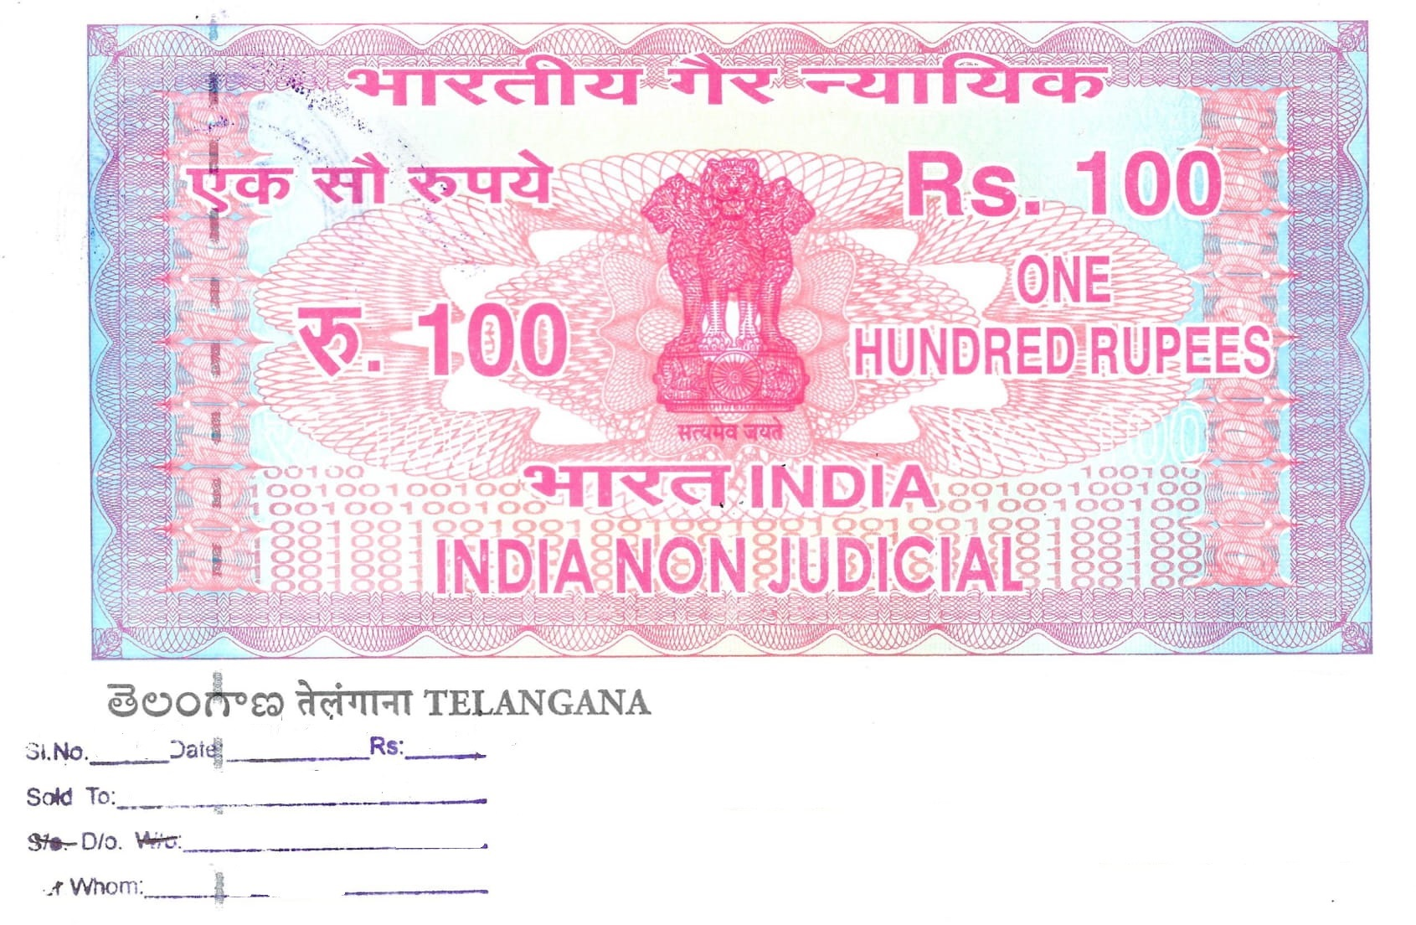
Stamp

Slide 6
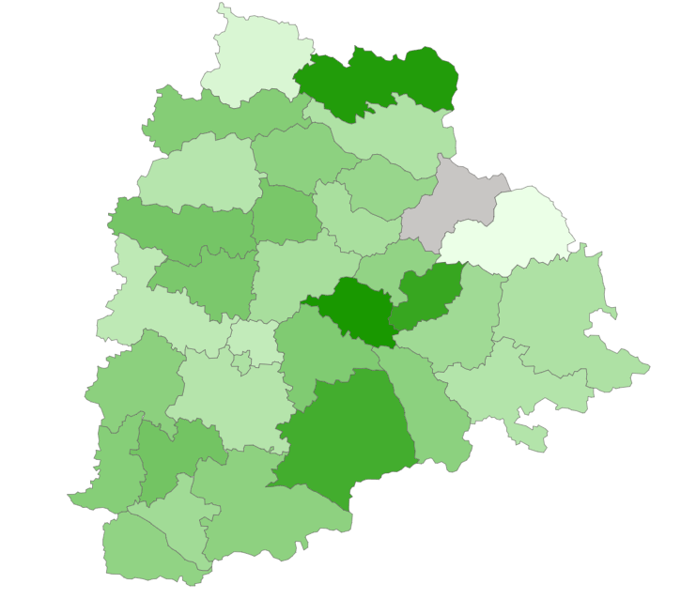
E-Stamp Challan Revenue Vs Document Registration Revenue
E-stamps Challan Revenue Vs Document Registration Revenue District-wise(FY2019-FY2022)
Top 5 Districts Where E-stamps Revenue Contributes Significantly More to Document based Revenue in FY2022
1
Jangaon
2
Nirmal
3
Mancherial
4
Rangareddy
5
Kamareddy

Slide 7
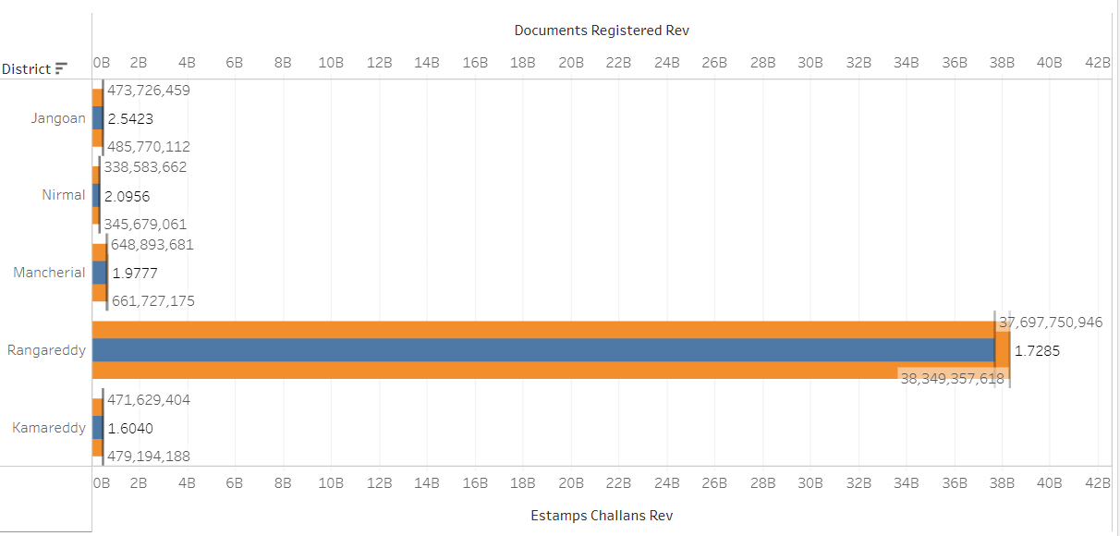
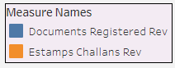
Top 5 Districts Where E-stamps Revenue Contributes Significantly More to Revenue in FY2022
Note: Middle value in each bar represents percentage difference

Slide 8
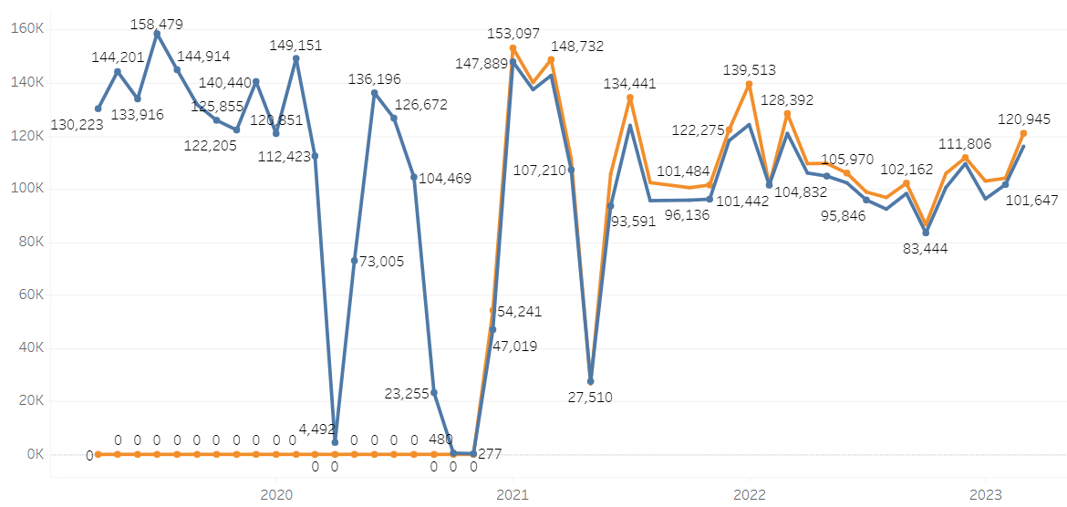
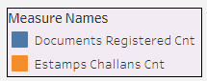
E-Stamp Challan Count Vs Document Registration Count
Almost no difference and the pattern is quite similar since the implementation of E-Stamp challan

Slide 9
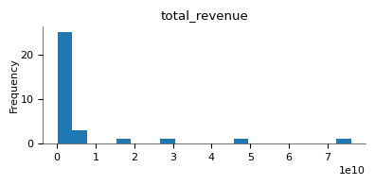
Stamp Registration Revenue(FY2022)

Slide 10
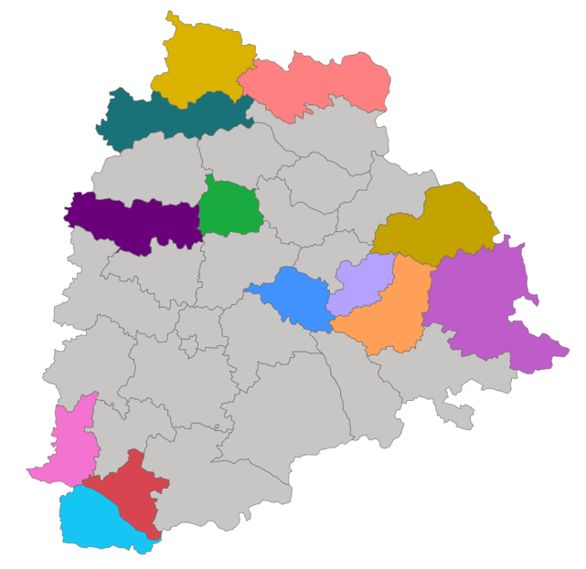
Districts with Stamp Registration Revenue below 10 Billion INR in FY2021

Slide 11
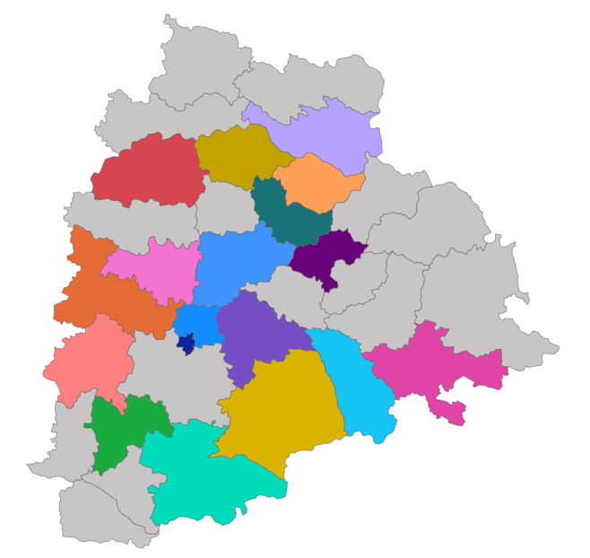
Districts with Stamp Registration Revenue between 10-50 Billion INR in FY2021

Slide 12
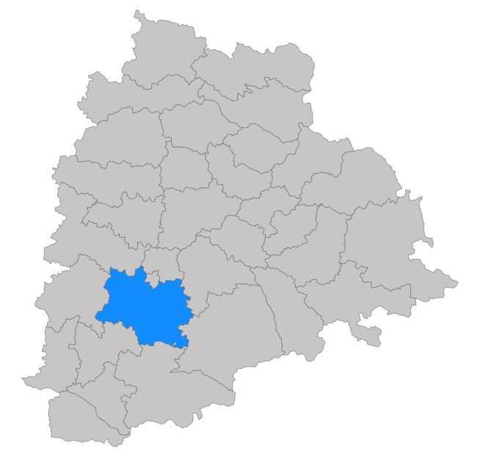
Districts with Stamp Registration Revenue above 50 Billion INR in FY2022

Slide 13
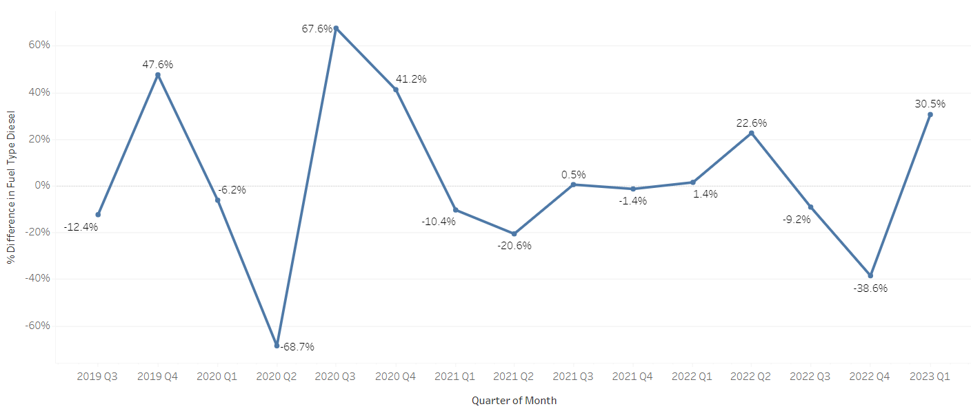
Diesel Vehicles – Quarter-wise sales

Slide 14
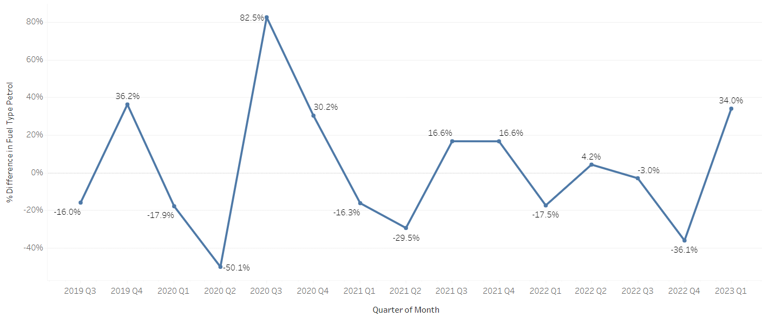
Petrol Vehicles – Quarter-wise sales

Slide 15
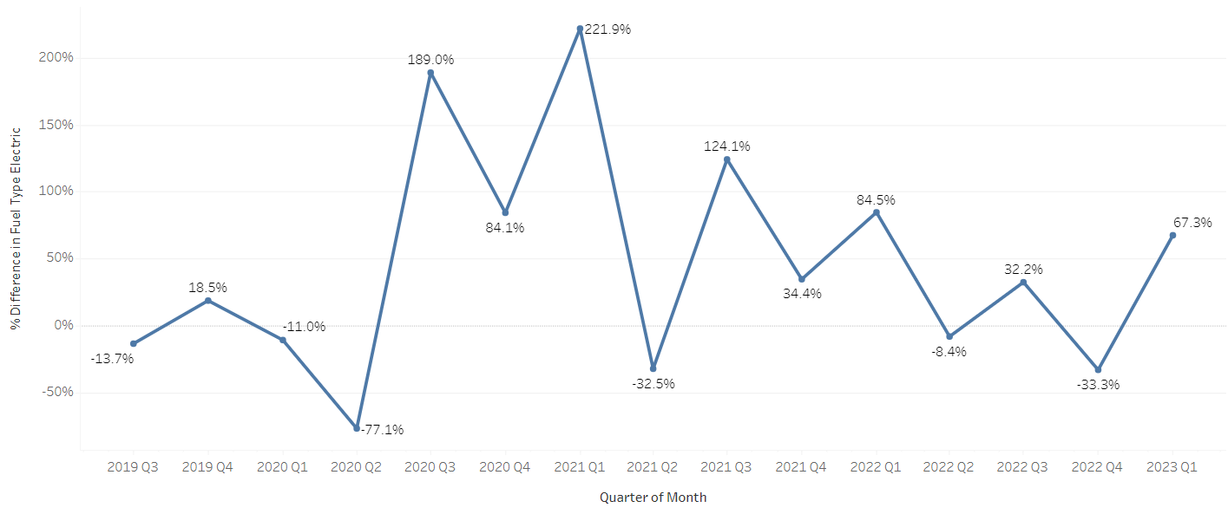
Electric Vehicles – Quarter-wise sales

Slide 16
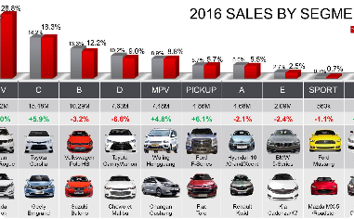
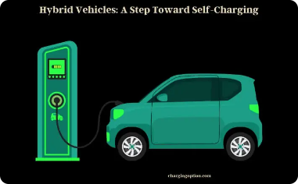

Vehicle Sales Analysis
Seasonal Sales Trends
Driving Factors
Vehicle Class Preferences
Higher fuel prices and a push towards green energy have led to an increase in the demand for hybrid and electric vehicles.
Vehicle sales tend to be higher during the festive season and lower during the summer months.
Motocycles are the preferred vehicle class across many districts, especially in rural areas.

Slide 17
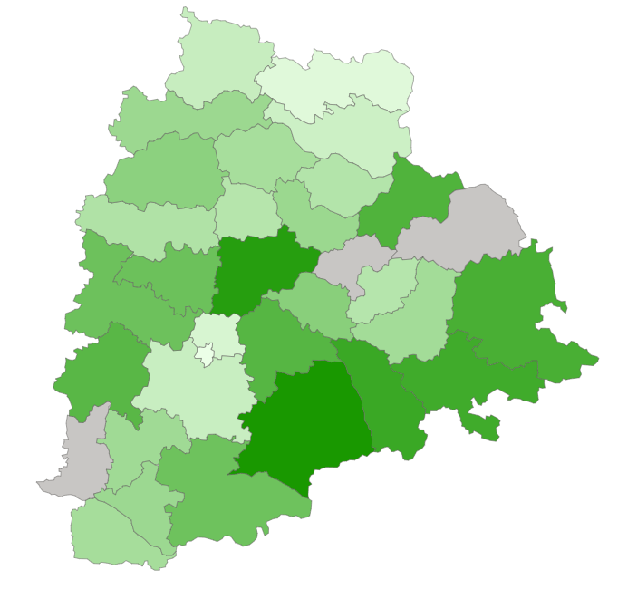
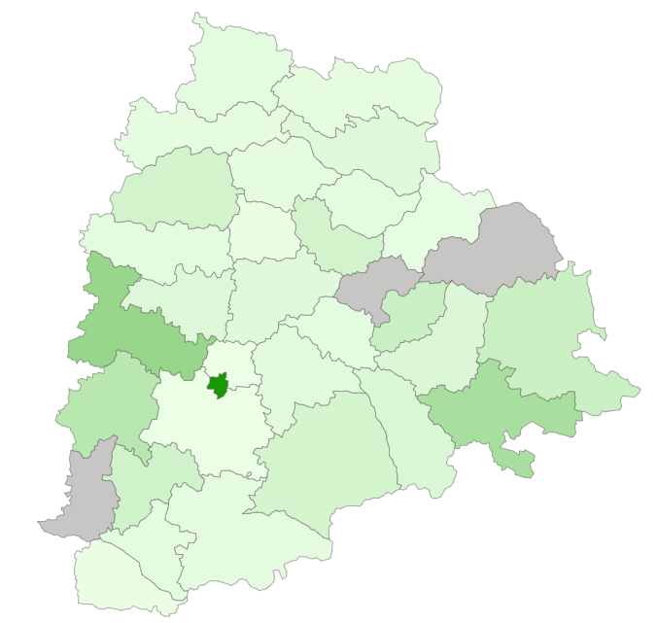
Vehicle Sales by Class(Motorcycle and Motorcar)
Motorcycle sales: Significant Contribution from South East Districts
Motorcar Sales : Significant Contribution from Hyderabad

Slide 18
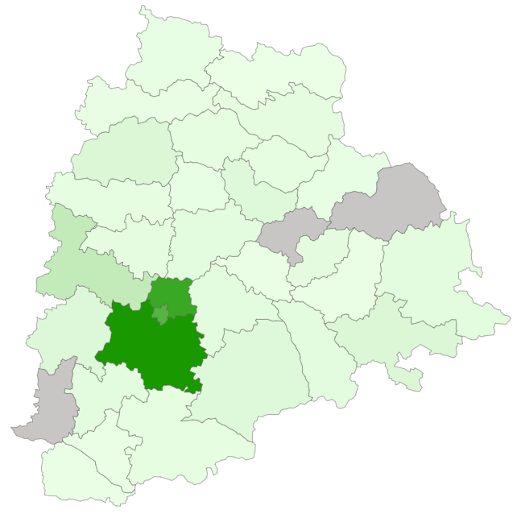
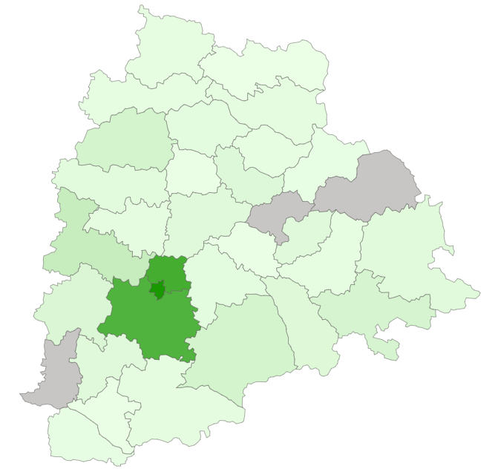
Vehicle Sales by Class(Autorickshaw and Agriculture)
Autorickshaw sales: Significant Contribution from Hyderabad and even more contribution from its neighbouring districts
Agriculture Sales : Significant Contribution from Hyderabad and slightly less but still significant contribution from its neighbouring districts

Slide 19
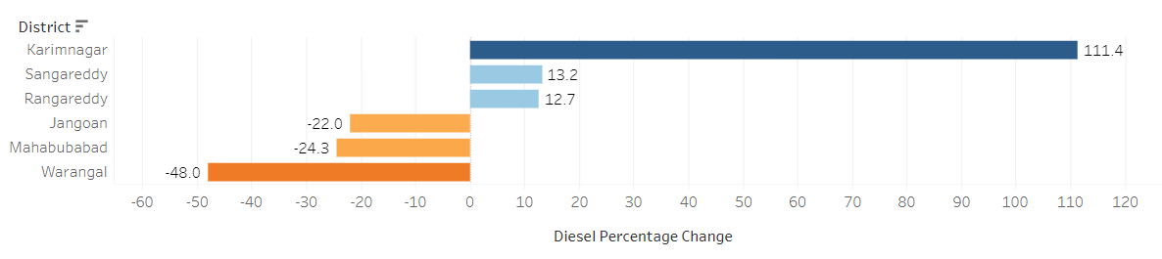
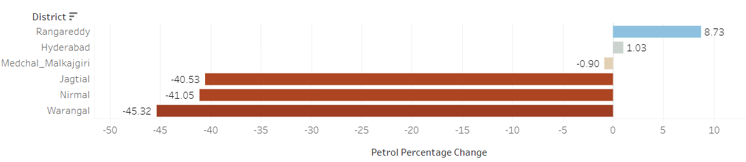
Diesel Vehicle Sales – Growth(FY2021 vs FY2022)
Petrol Vehicle Sales – Growth(FY2021 vs FY2022)

Slide 20
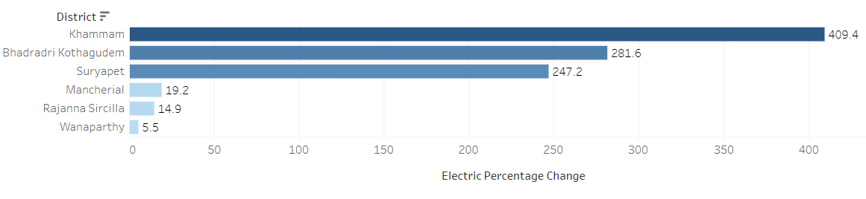
Electric Vehicle Sales – Growth(FY2021 vs FY2022)

Slide 21
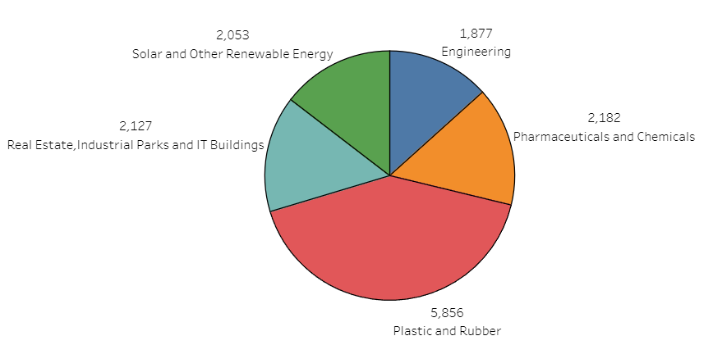
Top 5 Sectors with Most Significant Investments (FY2022)

Slide 22
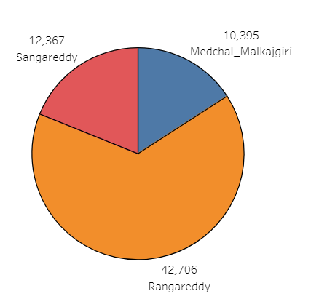
Top 3 Districts with Most Sector Investments (FY2019 – FY2022)

Slide 23
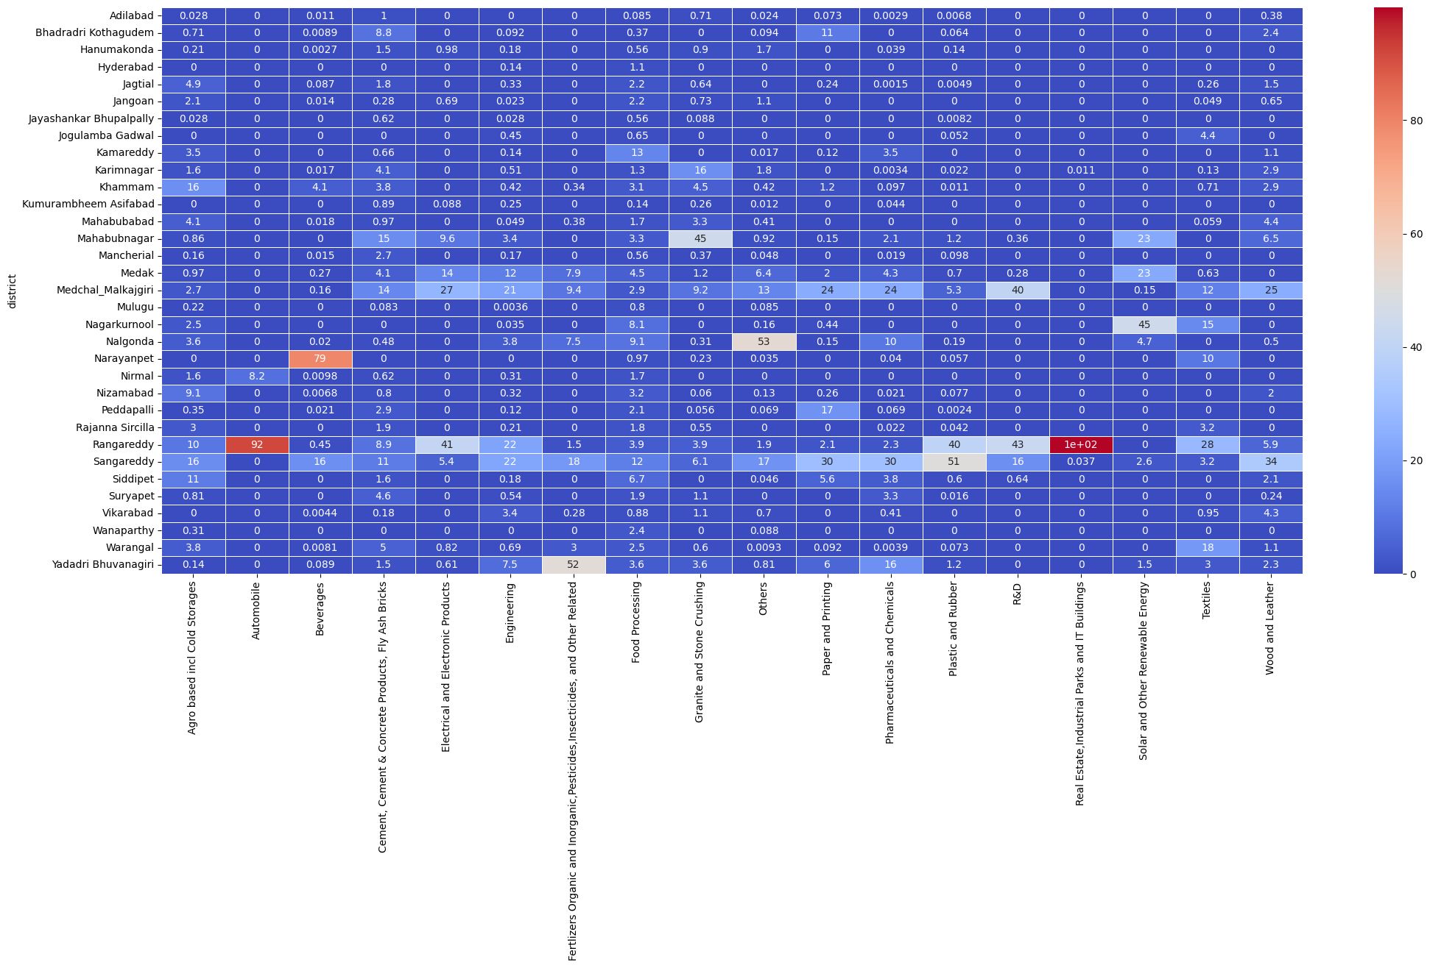
District vs Sector Investments– FY2021

Slide 24
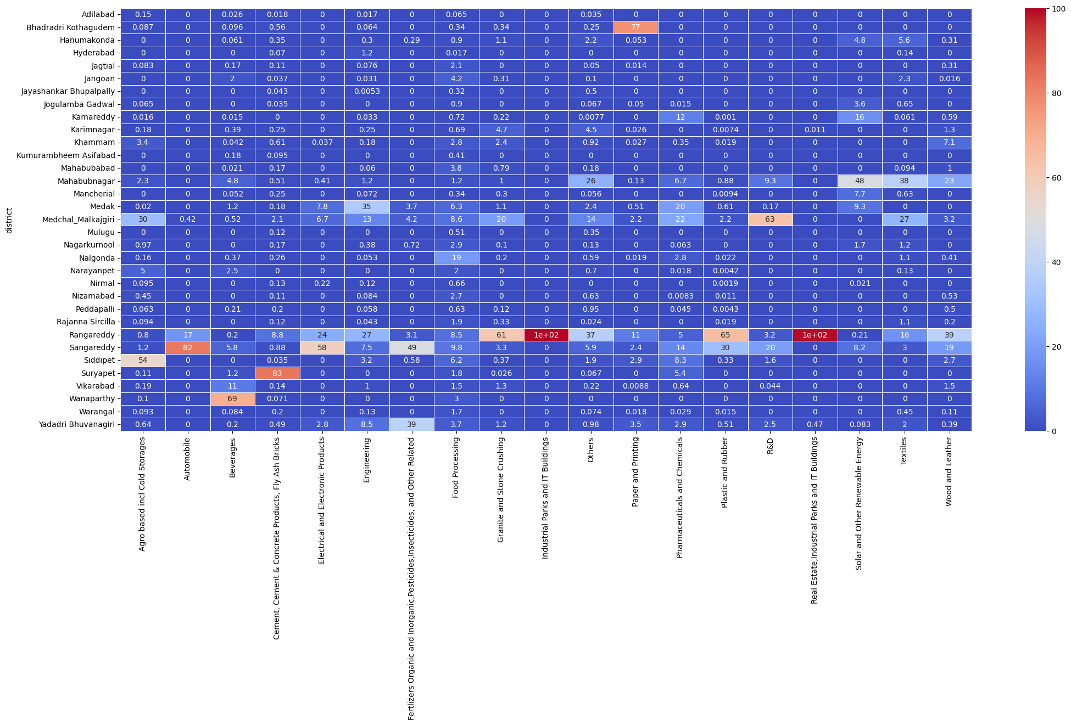
District vs Sector Investments– FY2022

Slide 25
Top 3 Districts with Most Sector Investments (Possible Reasons)
1
Rangareddy
Proximity to the capital city.
Extremely high investment in Real Estate and IT
Sangareddy
2
Proximity to the capital city.
High investment in Plastic and Rubber
3
Medchal Malkajgiri
Proximity to the capital city.
High investment in R&D
Multiple sector investment

Slide 26
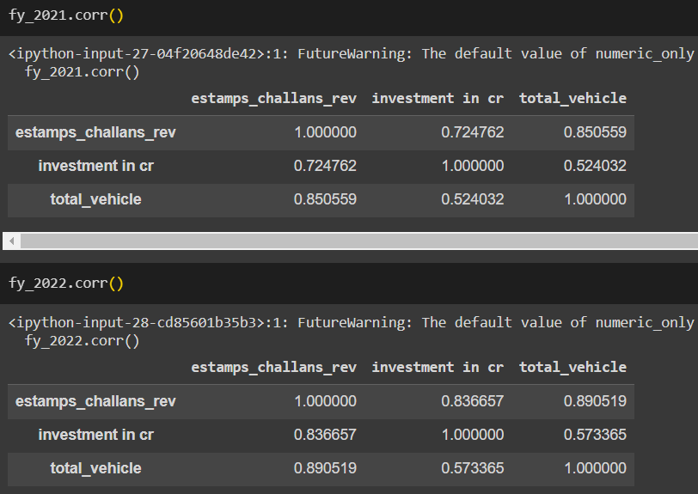
District Investment vs Vehicle Sales vs Stamp Revenue

Slide 27
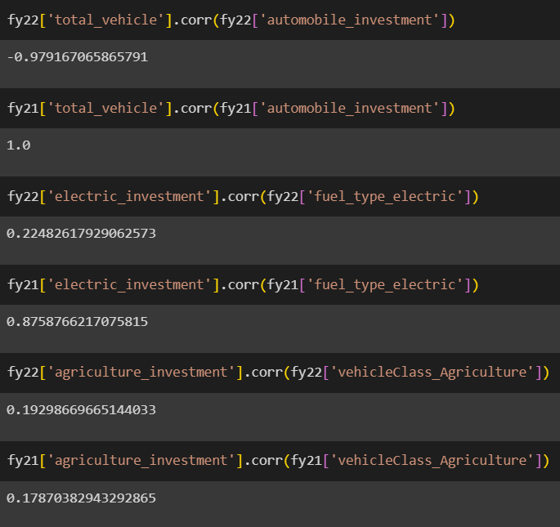
FY2022 Sector investment vs Vehicle sales

Slide 28
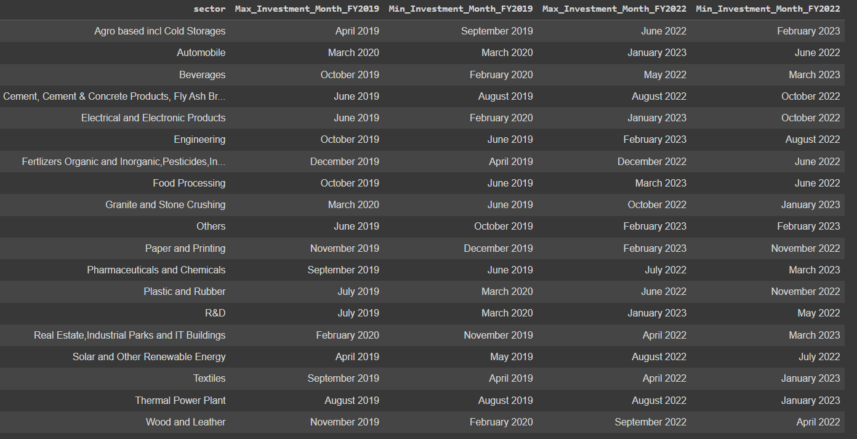
Sector investments – Monthly trends

Slide 29
Sector investments – Monthly trends - visualization
https://public.tableau.com/app/profile/jegan.balaji.b.s/viz/TelanganaGrowthAnalysis_16961010707980/Sheet1
Kindly check this link:
https://public.tableau.com/app/profile/jegan.balaji.b.s/viz/TelanganaGrowthAnalysis_16961010707980/Sheet1

Slide 30

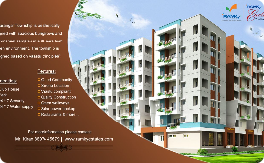
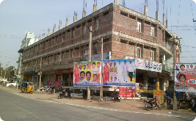
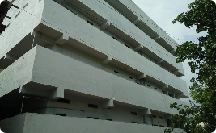
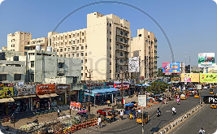
Top 5 Districts for Commercial Property Investment
Hyderabad
Warangal
Rangareddy
As the state capital, Hyderabad offers a thriving commercial market with a range of opportunities for investors.
With its rich history and expanding infrastructure, Warangal is becoming a hotspot for commercial property investments.
Known for its industrial growth and strategic location, Rangareddy is an emerging destination for commercial real estate.
Sangareddy
Medchal Malkajgiri

Slide 31



Boosting E-Stamp Registration in Telangana
Streamlined Online Process
Public Awareness Campaign
User-Friendly Mobile App
Simplify and digitize the e-stamp registration process, allowing users to easily register and pay online.
Launch an extensive awareness campaign to educate the public about the benefits and convenience of e-stamp registration.
Create a user-friendly mobile app that provides a seamless experience for e-stamp registration and document verification.

Slide 32
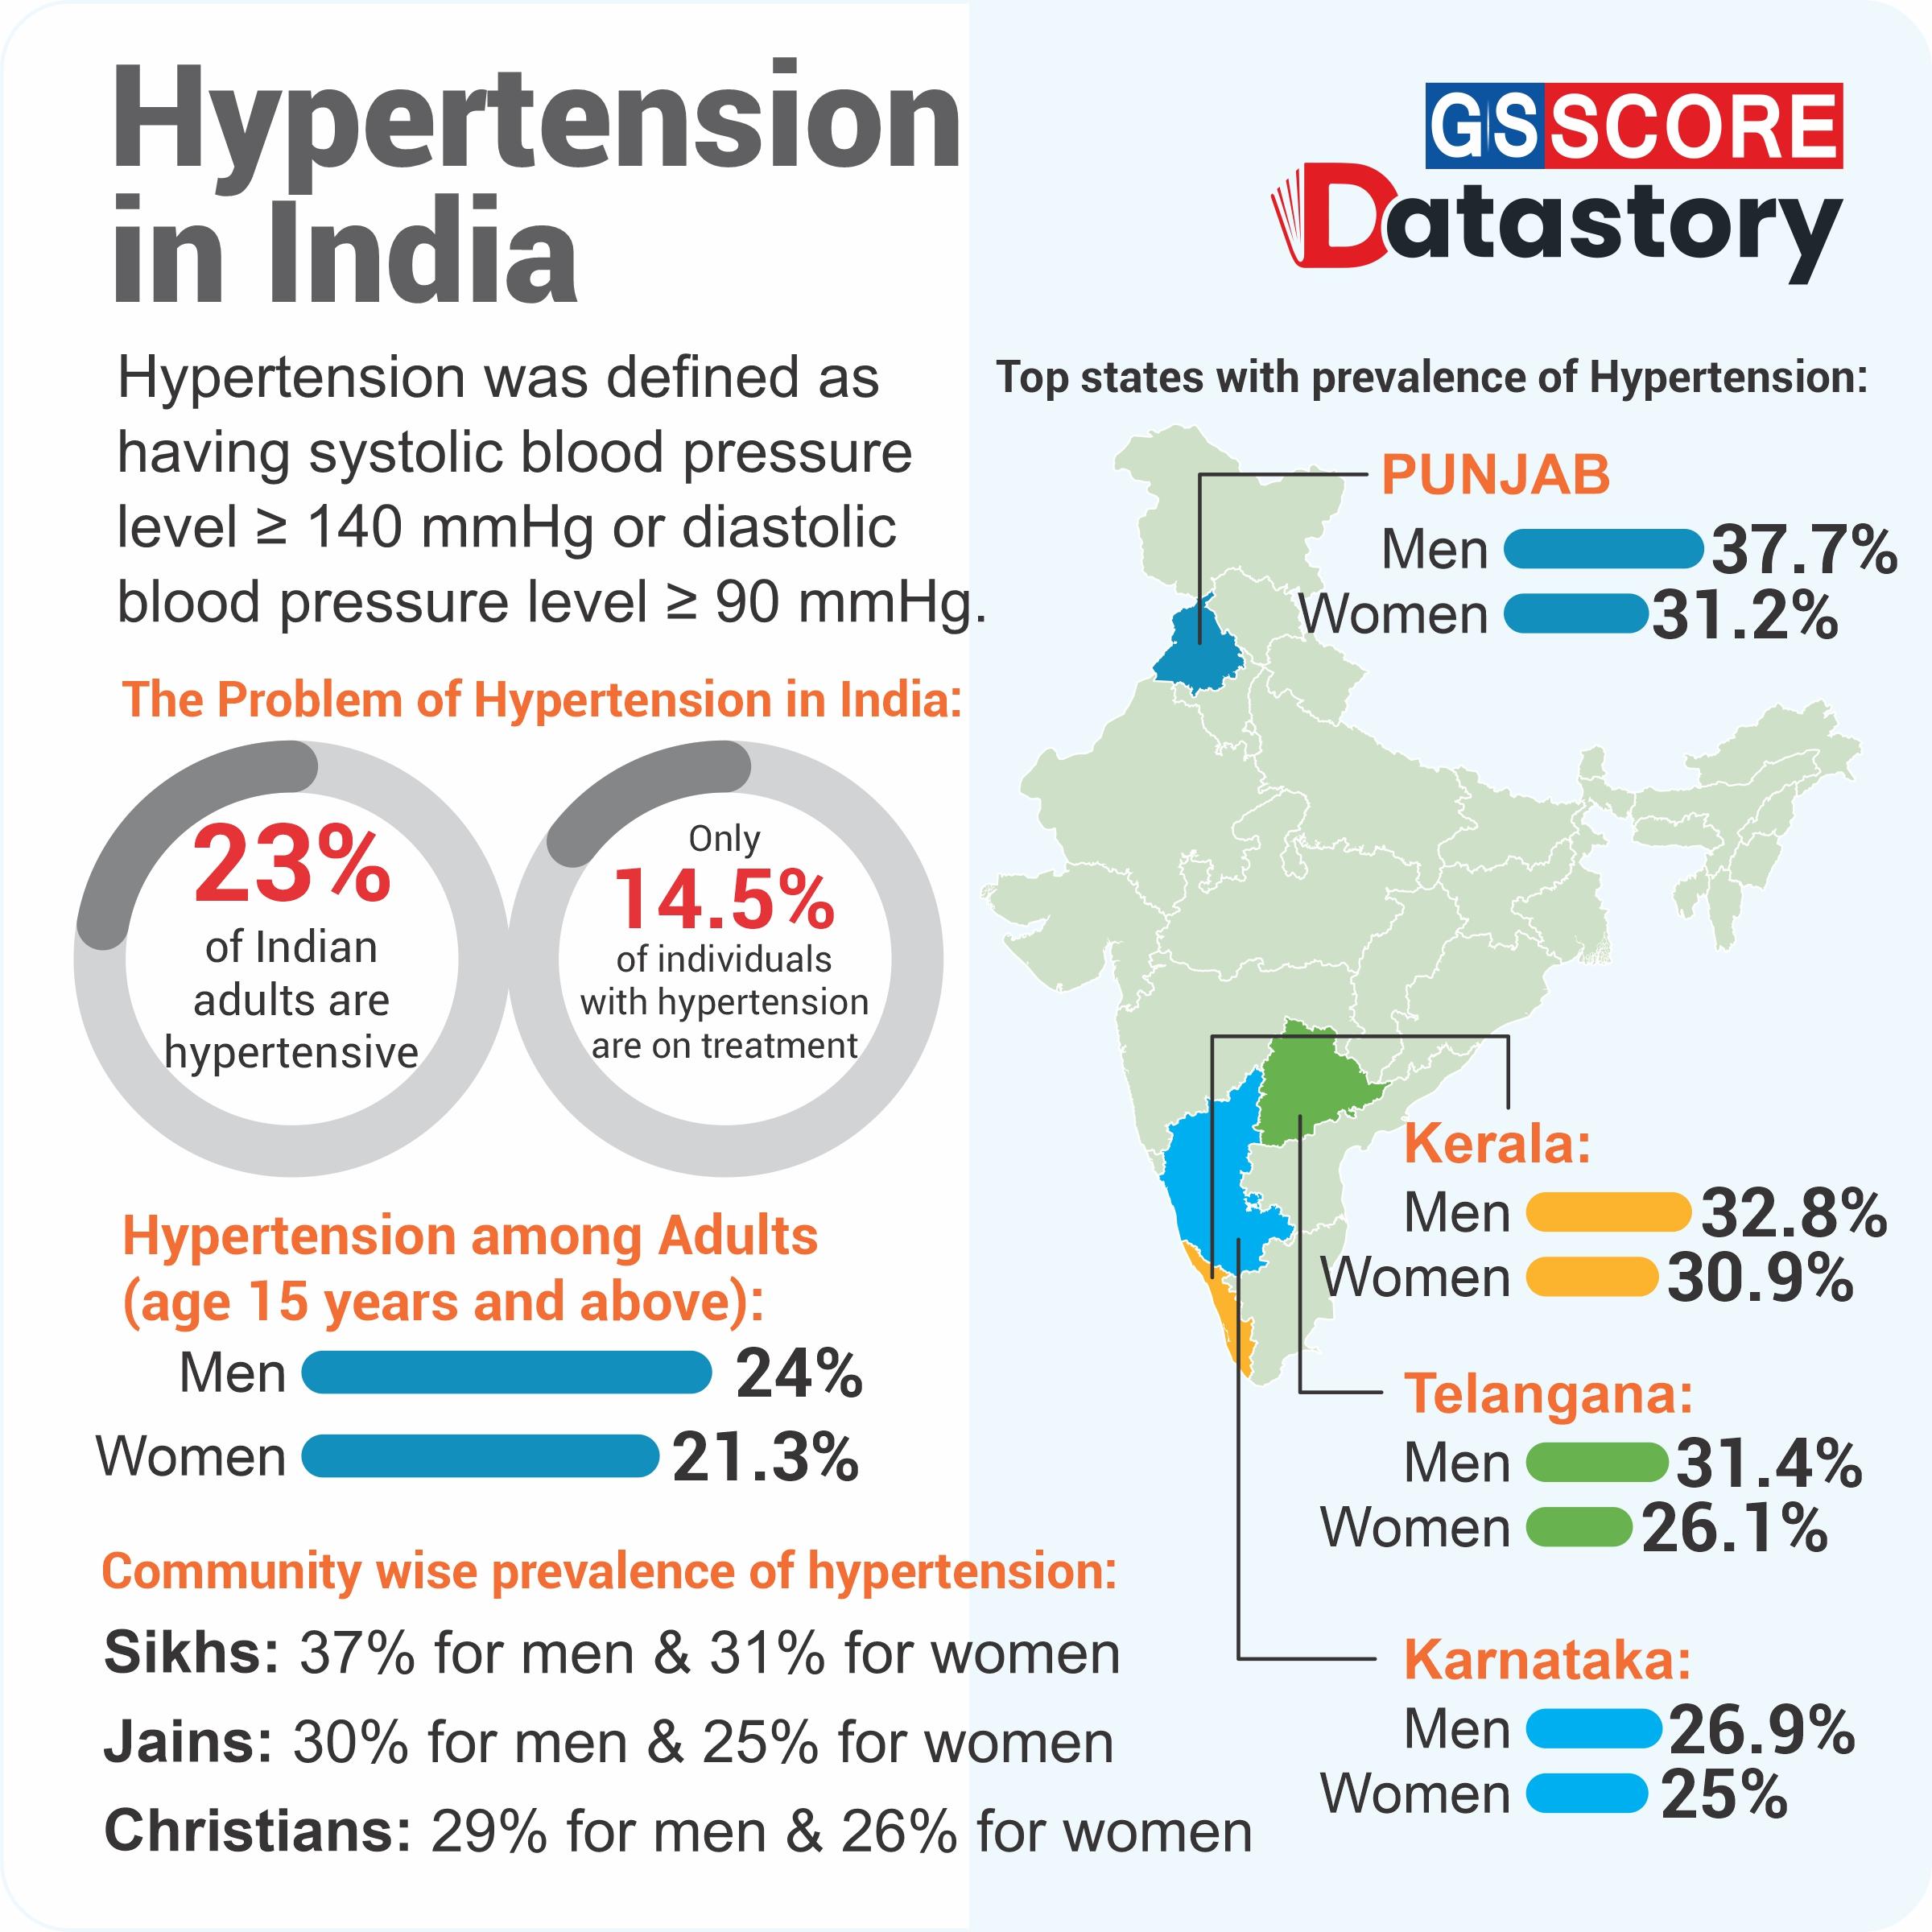
Hypertension

Slide 33

Tackling High Blood Pressure in Telangana
As many as 13 lakh people in Telangana were found to have high blood pressure (hypertension) during a 2022 survey which so far covered 90 lakh people, Health Minister T. Harish Rao said.
Experts estimate that one-third of the population has blood pressure issues.
The government should focus on raising awareness about the dangers of high blood pressure, encouraging healthy lifestyle habits, and providing access to affordable healthcare for all citizens.

Slide 34
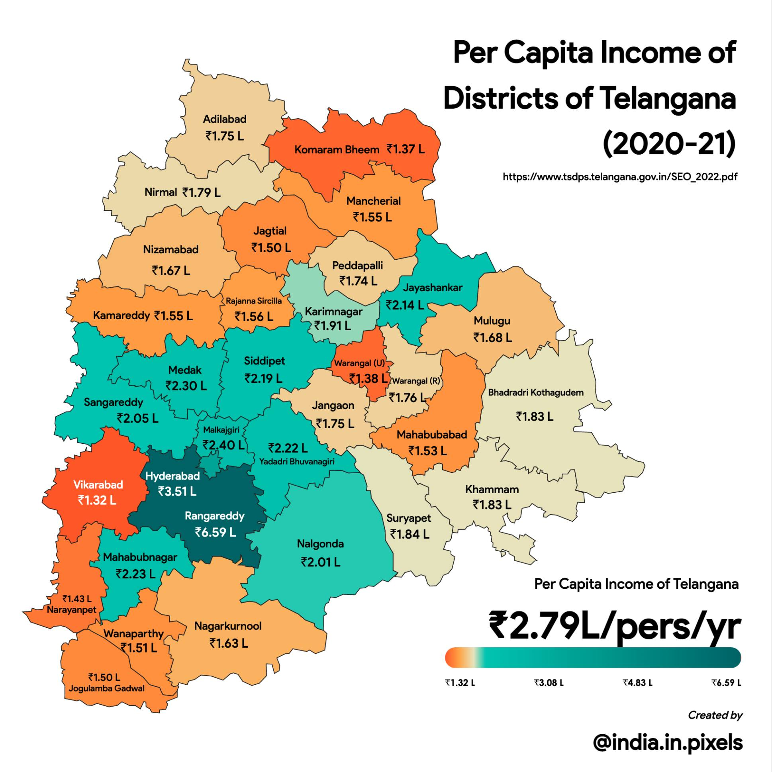
Per Capita Income

Slide 35
Strategies to Raise Per Capita Income in Districts with Lower Annual Per Capita Income in Telangana
Encouraging entrepreneurship and small business development through training programs, access to capital, and tax incentives.
Developing and promoting sectors with high potential for growth, such as tourism, IT, and manufacturing.
Providing quality education and training programs that are aligned with the job market needs to increase employment opportunities and higher-paying jobs.
Improving infrastructure, including transportation and communication networks, to increase access to markets and opportunities.
Strengthening social safety net programs to assist the vulnerable population and ensure they have access to basic necessities and services.
Implementing these strategies can increase economic growth, create jobs, and raise the per capita income of districts with lower annual per capita income in Telangana.

Slide 36
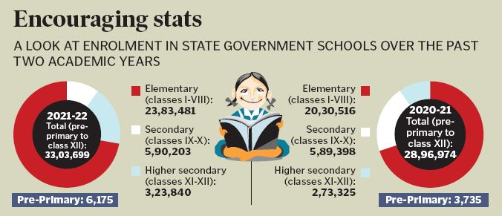
Telangana – Gross Enrollment Ratio increasing

Slide 37



Investing in Telangana Education
Telangana's allocation of only 7.6% of its expenditure on education in 2023-24 is lower than the average allocation for education by states in 2022-23 (14.8%).
Tamil Nadu has the 3rd highest Gross Enrollment Ratio at tertiary level and allocates a lion's share for education in its annual budget almost every year.
It is recommended that the Telangana government increase its education expenditure to improve the quality of education and increase access to education for all citizens of Telangana.

Slide 38

THE END
I would like to express my thanks to :
Dhaval Patel, Founder of Codebasics
Hemanand Vadivel, Co-Founder and CEO of Codebasics
Kalvakuntla Taraka Rama Rao / KTR, Minister for IT, Industries and Municipal Administration
Kalvakuntla Chandrashekar Rao, Chief Minister of Telangana

